Slide 1
IoT BASED SMART AGRICULTURE SYSTEM
-AKARSH RAI
INTERNSHIP: SMART AGRICULTURE BASRD ON IOT –SB38243|
PROJECT ID: SPS_PRO_101

Slide 2
OVERVIEW:
A web application used to control motors in agricultural field from remote locations using data uploaded to the cloud from the field
The web application collects data generated by the IoT simulator from the cloud and displays it.
Depending on the data, the user can control the motors from any remote location via internet.

Slide 3
BLOCK DIAGRAM

Slide 4
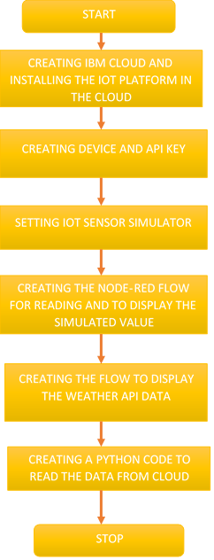
Steps

Slide 5
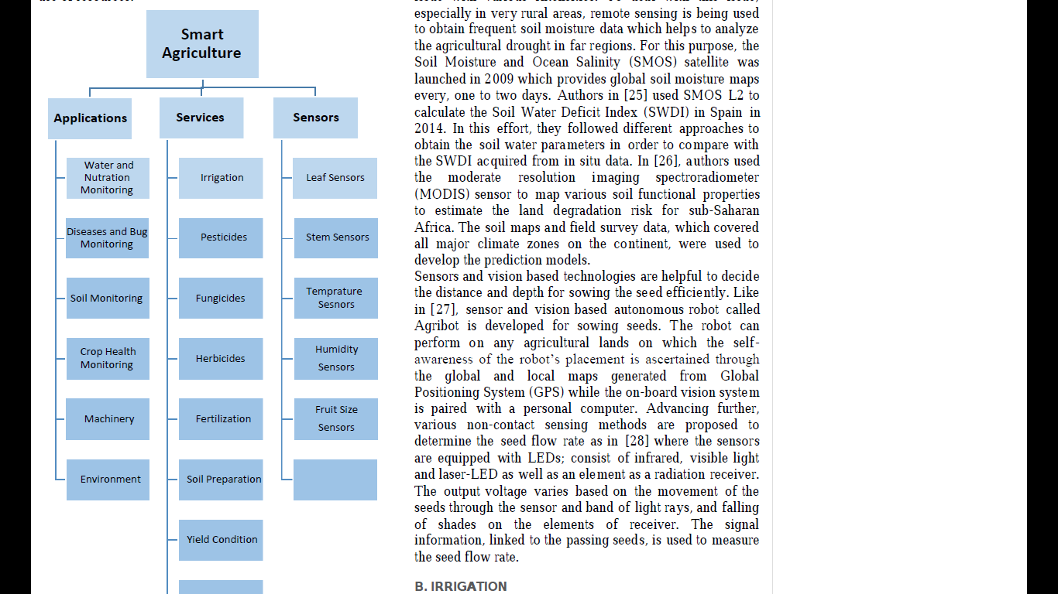
FUTURE SCOPE
Future work would be focused more on increasing sensors on this system to fetch more data especially with regard to Pest Control and by also integrating GPS module in this system to enhance this Agriculture IoT Technology to full-fledged Agriculture Precision ready product

Slide 6
CONCLUSION
Smart agriculture System helps farmers to predict the upcoming weather forecast and prevent a lot of crop damage and loses, helps in increasing the quality and quantity of crop production and also helps in reducing few human efforts.

